Slide 1
Java Crash Course
Session 1
CODERS

Slide 2
Refresher
https://docs.google.com/presentation/d/1hVAjlJFqZYxc9KnU1FakFXV8u4mjaZcwzOIGW187sEk/edit#slide=id.g48794603d2_2_176
This is a slightly more condensed version of last session.

Slide 3
Write me this program!
First make a new Java project folder.
Next make this program!
I want a program that simulates a car moving! I want a car that has a position and a velocity (speed). Then I want to see where it is at the first second, second second, third second, and so on.
For example, I want the car to start at 0 meters and to have a velocity of 5 meters per second (m/s). My program could print something like this.
Vroom! I am at meter 5 traveling at 5 m/s.
Vroom! I am at meter 10 traveling at 5 m/s.
Vroom! I am at meter 15 traveling at 5 m/s.

Slide 4
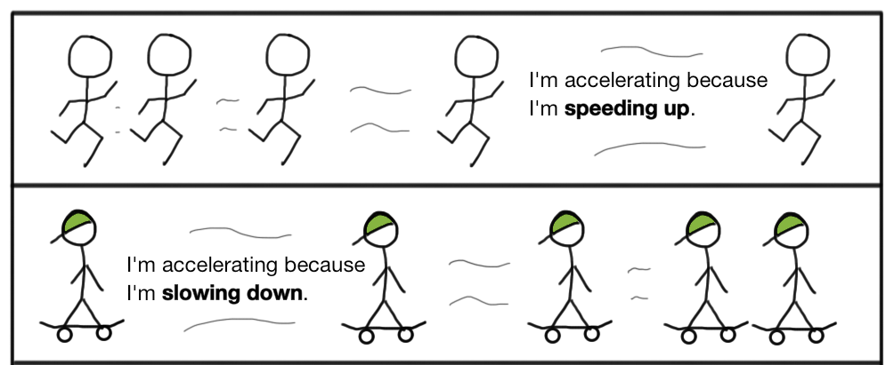
Challenge!

Slide 5
Challenge
Modify your program to also include acceleration (the change of velocity). When you update your position, also update your speed according to your velocity.
Example:
Variables set as:
position = 0;
velocity = 5;
acceleration = -2.5;
Output:
Vroom! Car is at position 2.5 and travelling at 2.5 m/s!
Vroom! Car is at position 2.5 and travelling at 0.0 m/s!
Vroom! Car is at position 0.0 and travelling at -2.5 m/s!

Slide 6
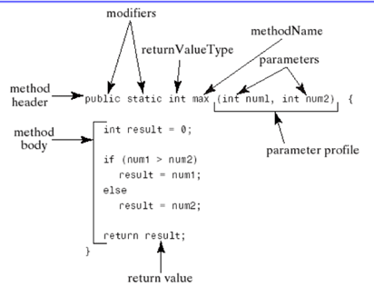
Methods
Use information to do something with it.
Give something.
How to make a method:

Slide 7
Methods
void methods
public void greet(String name) {
System.out.println("Hello " + name + "!");
}
non-void methods
public int add(int a, int b) {
int sum = a + b;
return sum;
}
greet("Marco");
int x = add(2,5);
System.out.println(x);

Slide 8
Scope
Local scope
int x = 5;
if (x > 5) {
int y = 10;
}
System.out.println(y);

Slide 9
Scope
Global Scope
public static void main(String[] args) {
int x = 4;
}
public static void printX() {
System.out.println(x);
}
VS
static int x;
public static void main(String[] args) {
x = 4;
}
public static void printX() {
System.out.println(x);
}
Note the int x needs the keyword static before it because we are using a static method. You will see later where you don’t need to say static

Slide 10
Objects
Have attributes -> Data that belongs to an object. A description or adjective.
Has a constructor -> How to build the object
Behaviors or actions -> Methods it contains. An action or verb.

Slide 11
Declaration and Instantiation
Declaration:
Associate a variable name with a type.
Box myBox;
Instantiation:
Calls the constructor, which builds the object
myBox = new Box(5, 5, 5);
This can also be done on the same line:
Box myBox = new Box(5, 5, 5);

Slide 12
public class Box {
/* Attributes of the box */
private int length;
private int width;
private int height;
/* Constructor */
public Box(int length, int width, int height) {
this.length = length;
this.width = width;
this.height = height;
}
/* Methods */
public int getVolume() {
int volume = length * width * height;
return volume;
}
public void grow() {
length = length + 1;
width = width + 1;
height = height + 1;
}
public void shrink() {
length = length - 1;
width = width - 1;
height = height - 1;
}
}

Slide 13
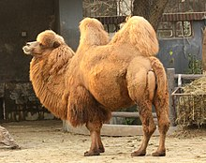
Coding Conventions / Syntax:
Naming
Variable names: variableName (camel case)
Class names: ClassName (mixed case)
Methods: methodName (camel case)

Slide 14
Car Program
https://github.com/saheethao/CODERS/tree/master/session1/01-car-program

Slide 15
Car Program With Methods
https://github.com/saheethao/CODERS/tree/master/session1/02-car-program-with-methods

Slide 16
Car Program With More Cars
https://github.com/saheethao/CODERS/tree/master/session1/03-car-program-with-more-cars

Slide 17
Car Program With Objects and Car Race
https://github.com/saheethao/CODERS/tree/master/session1/04-car-race

